Slide 1

VIDEO GAMES – OVER THE YEARS
By Marta, Matthew & Jamie

Slide 2
Overview

Slide 3
Main changes
Splitscreen to Online
Difference in graphic fidelity
Popularity
Loot boxes
More Indie Games!
Progression vs Pay-2-Win
Rise of Battle Royales
THE ARCADE

Slide 4
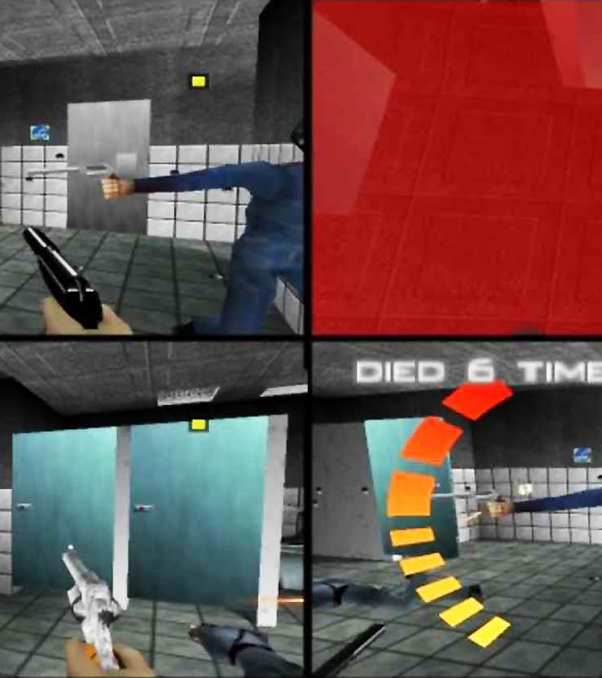
Multiplayer - Splitscreen
In the 90s, multiplayer games were exclusively splitscreen.
2 – 4 Players
All in the same room
“Screenwatching” 😡

Slide 5
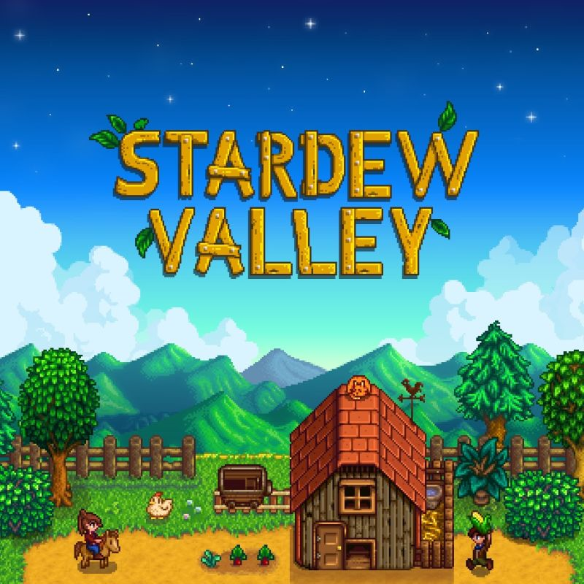
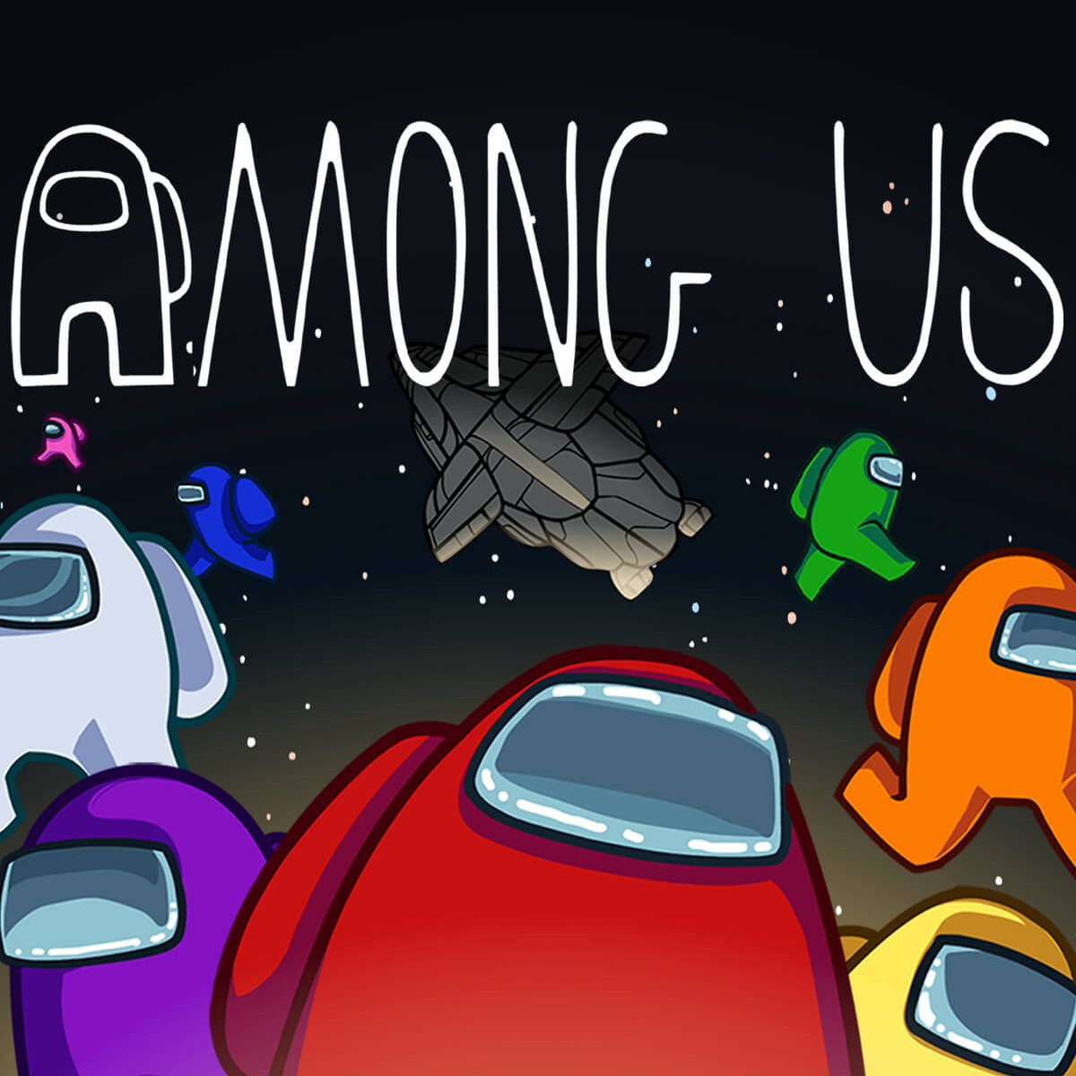


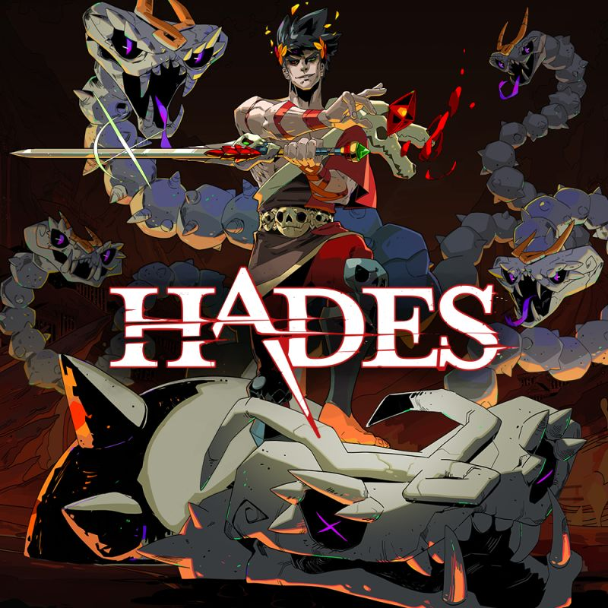
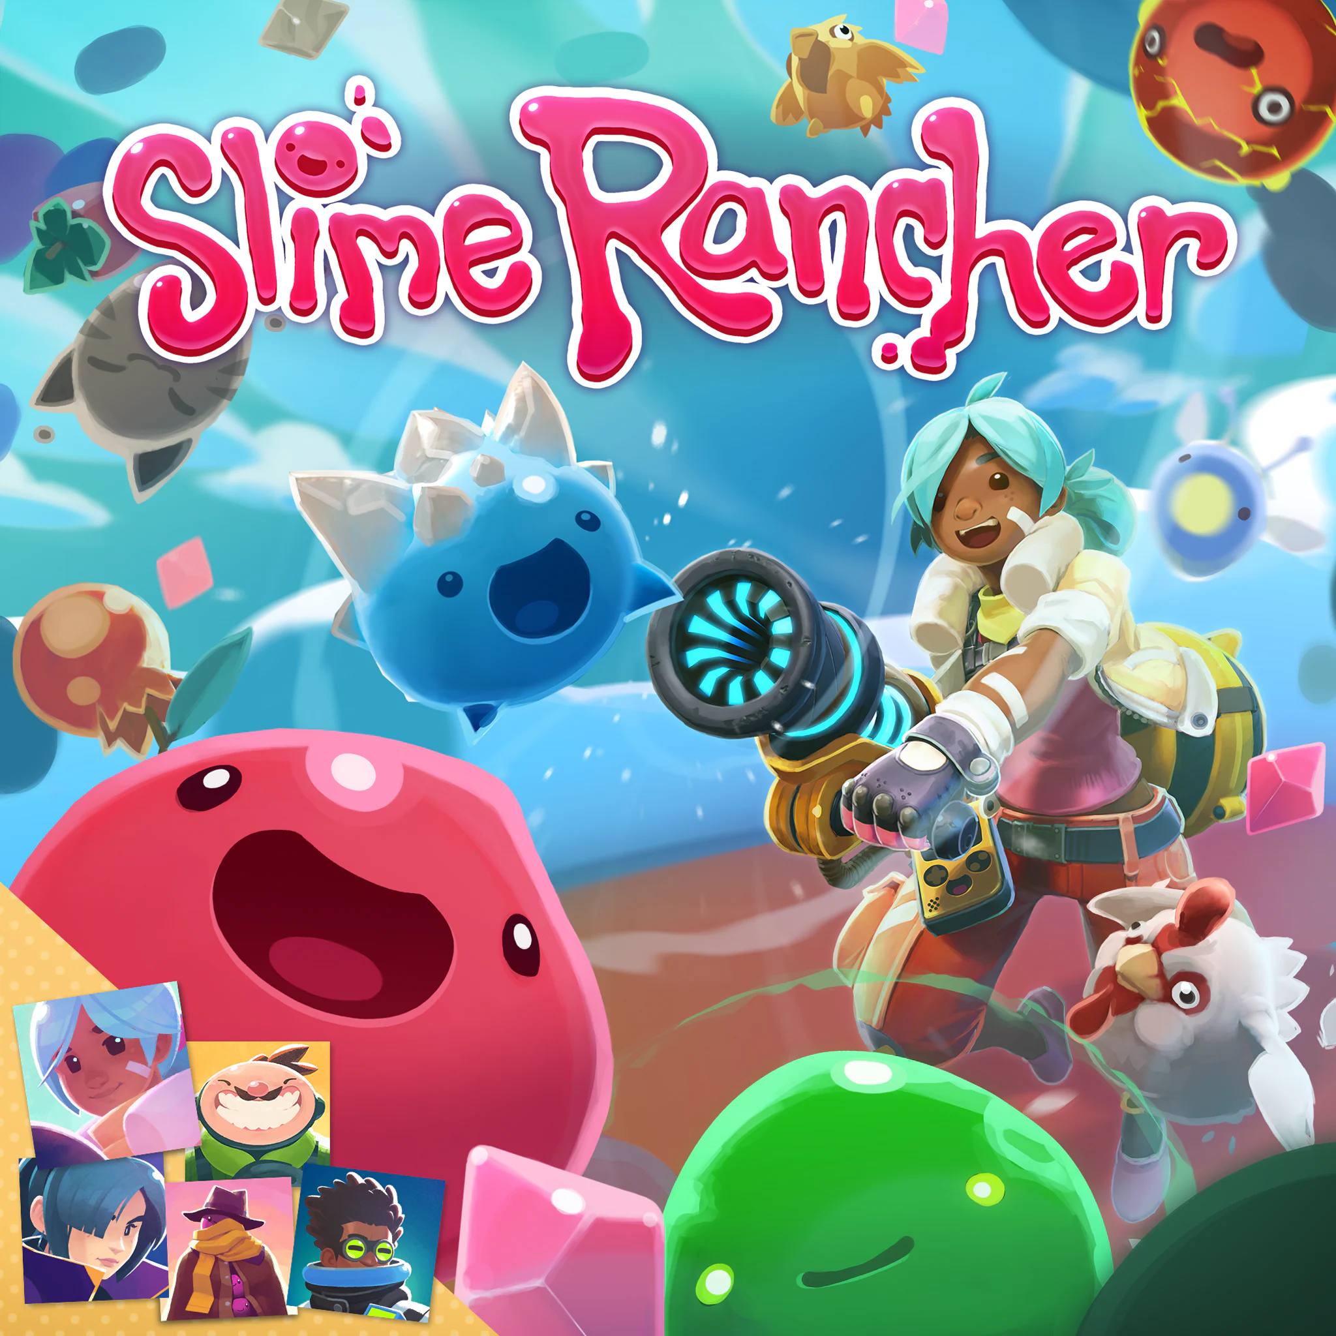
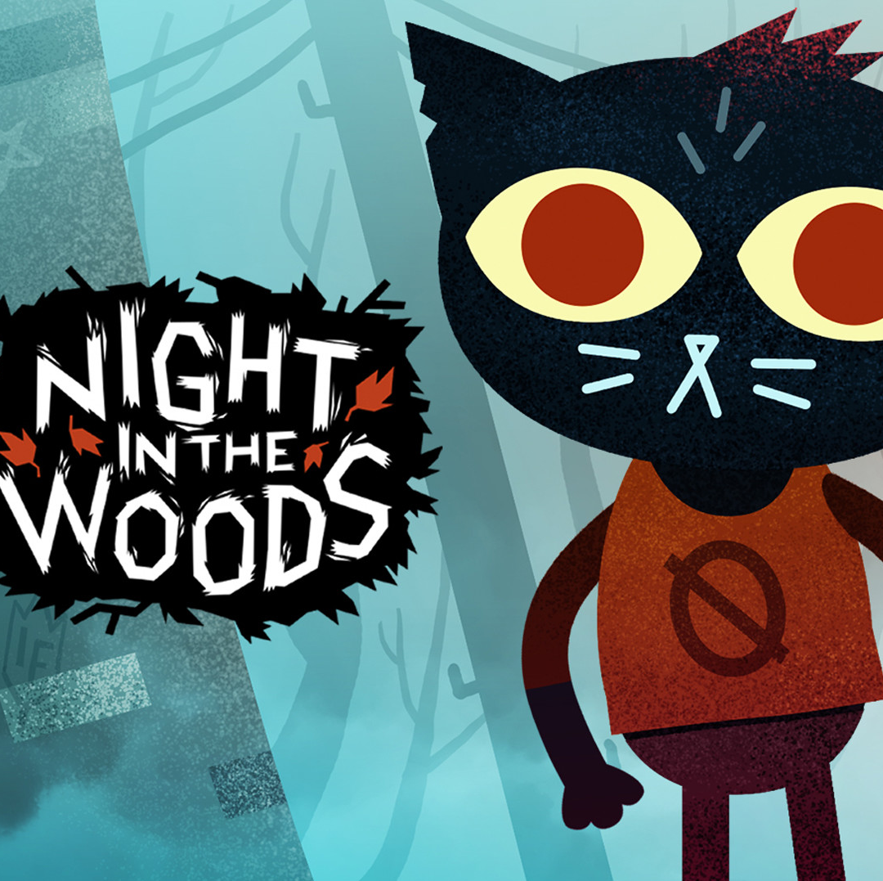

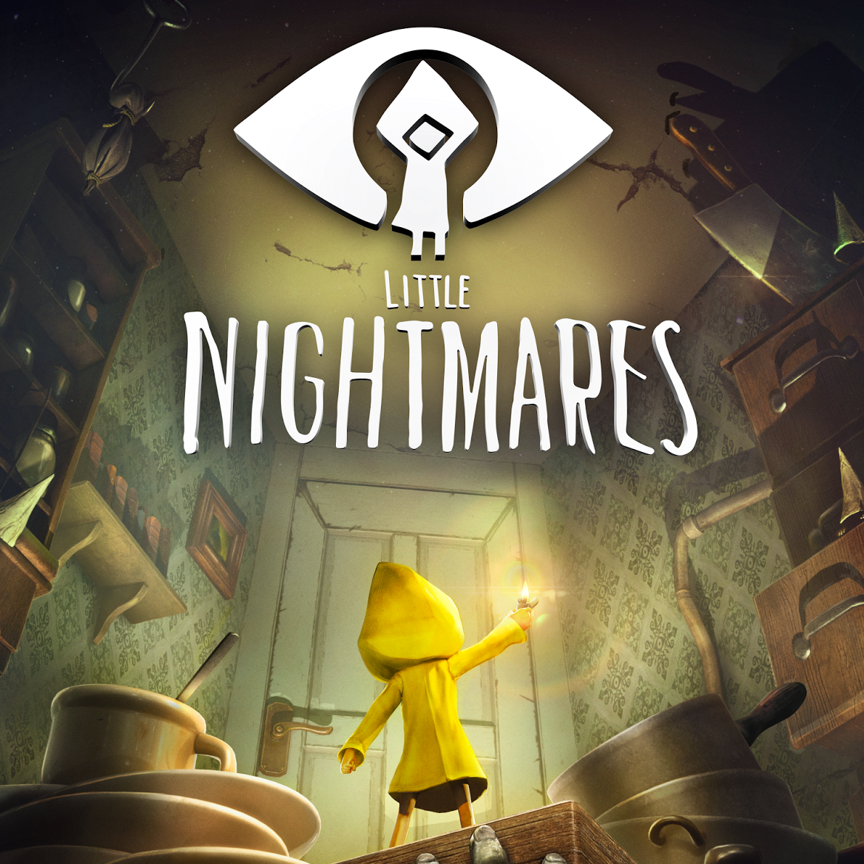


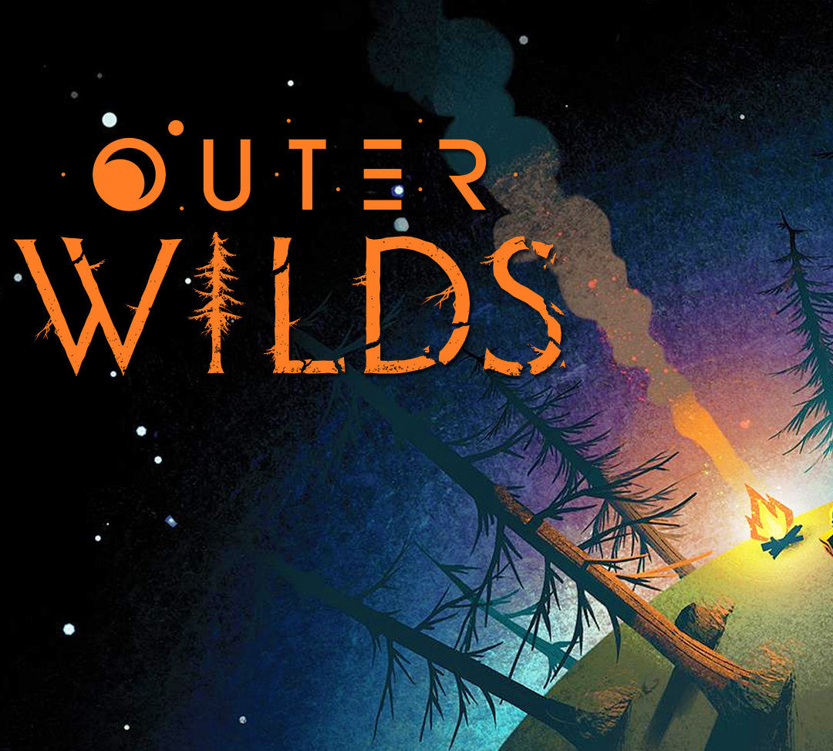
Rise of Indie Games

Slide 6
Then vs Now
Traditionally, most games were only made by renowned game studios and published by big companies.
Indie games are games developed by independent games developers consisting of few or even 1 persons.
Indie games have become very popular over the years, granting the freedom and flexibility for people to make and publish their own games.
Indie games were around in the early 2000s, albeit rare. They gained traction a lot more during 2010s.

Slide 7
Main Differences
Indie Games
Triple A Games
Solo or small teams
Low Budget
More creative control
Tend to be lesser known
Indie Developers are their own boss
Smaller, closely-knit communities
Most are only available on PC
Cheaper (£10+)
Solo or small teams
High Budget
More controlled – revisions made often
Well known – highly marketed
Decisions are determined by higher-ups
Larger and expanding communities
Are usually found on PC and/or Consoles
More expensive (£50+)

Slide 8

List of Indie Games
Among Us
Stardew Valley
Cult of the Lamb
Five Nights at Freddy’s
Crypt of The Necrodancer
Cuphead
Baldi’s Basics in Education & Learning
Don’t Starve
Subnautica
Kerbal Space Program
Hollow Knight
Night in The Woods
Undertale
The Binding of Isaac
Hotline Miami
Superhot
Friday Night Funkin’
Fall Guys
Outlast
Hades
Risk of Rain
Deep Rock Galactic
Deltarune
Faster Than Light
Helltaker
Getting Over It with Bennett Foddy
Enter The Gungeon
Celeste
A Hat In Time
Hylics
Little Nightmares
Indivisible
Inscryption
Iron Lung
Journey
Jump King
LISA: The Painful
Metal: Hellsinger
Minecraft
Neon White
No Man’s Sky
Omori
Outer Wilds
Ori & The Blind Forest
Phasmophobia
Rivals of Aether
Rogue Legacy
Sable
Scorn
SCP – Containment Breach
Shantae
Shovel Knight
Sifu
Skullgirls
Slime Rancher
Soma
Spelunky
Stray
Transistor
Untitled Goose Game
VA-11 Hall-A
Vampire Survivors
Viscera Cleanup Duty
VRChat
World of Horror
Yume Nikki
+ 1000s more

Slide 9
Rise of Battle Royales

